Slide 1

DEEP LEARNING
MODULE # 6 : RECURRENT NEURAL NETWORK [RNN]

Slide 2
In feedforward and convolutional neural networks The size of the input is always fixed.
Each input to the network is independent of the previous or future inputs.
The computations, outputs and decisions for two successive inputs / images are completely independent of each other.

Slide 3
This is not true in many applications.
The size of the input is not always fixed.
Successive inputs may not be independent of each other.
Each network (blue - orange - green structure) is performing the same task – input : character output : character.
Example: Auto-completion.
e e
p
eow
d
e e
p

Slide 4




In This Segment
Sequence Learning
Recurrent Neural Network (RNN) Types of RNN
Learning in RNN Issues in RNN
Long Short Term Memory Unit (LSTM) Gated Recurrent Unit (GRU) Bidirectional RNN
1
2
3
4
5
6
7
8

Slide 5
Sequence Learning Problems
To model a sequence we need
Process an input or sequence of inputs.
The inputs may have be dependent.
We may have to maintain the sequence order.
Each input corresponds to one time step.
Keep track of long term dependencies.
Produce an output or sequence of outputs.
Supervised Learning.
Share parameters across the sequences.

Slide 6
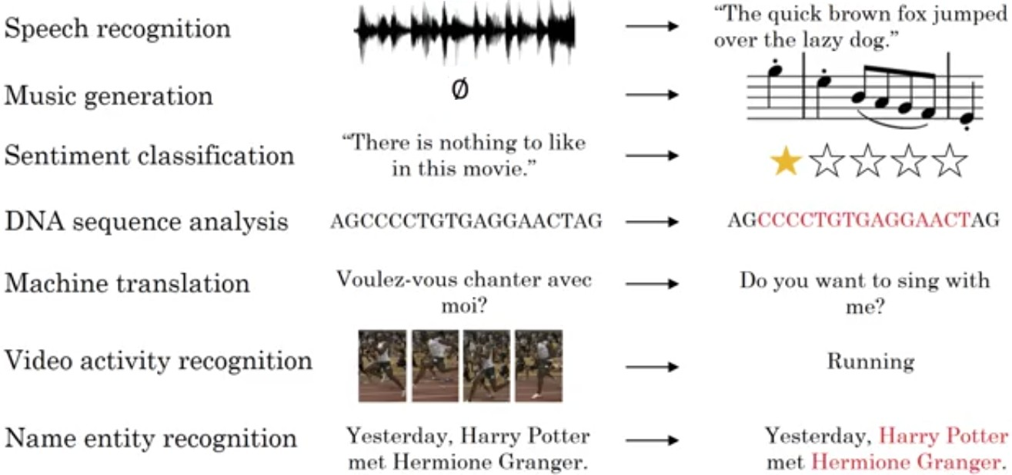
Sequence Model
Courtesy: Andrew Ng

Slide 7
Part of Speech Tagging
Task is predicting the part of speech tag (noun, adverb, adjective, verb) of each word in a sentence.
When we see an adjective we are almost sure, the next word should be a noun.
The current output depends on the current input as well as the previous input.
The size of the input is not fixed. Sentences have any number of words.
An output is produced at end of each time step.
Each network is performing the same task – input : word, output : tag.
noun
verb
article adj
noun
Apple is a
red fruit

Slide 8
Sentiment Analysis
Task is predicting the sentiment of a whole sentence.
Input is the entire sequence of inputs.
An output is not produced at end of each time step.
Each network is performing the same task – input : word, output : polarity +/−.
(-)
The movie was
boring and
long

Slide 9

In This Segment
Sequence Learning
Recurrent Neural Network (RNN) Types of RNN
Learning in RNN Issues in RNN
Long Short Term Memory Unit (LSTM) Gated Recurrent Unit (GRU) Bidirectional RNN
1
2
3
4
5
6
7
8

Slide 10
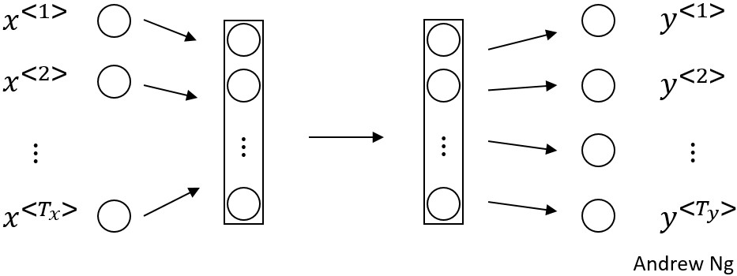
Recurrent Neural Network (RNN)
Accounts for variable number of inputs.
Accounts for dependencies between inputs.
Accounts for variable number of outputs.
Ensures that the same function executed at each time step.
The features learned across the inputs at different time step has to be shared.

Slide 11
RNN I
The function learned at each time step.
t = time step
x_{t} = input at time step t s_{t} = σ(Ux_{t} + b)
y_{t} = g(Vs_{t} + c)
yˆ₁
yˆ₂
yˆ₃
V
s₁
V
s₂
V
s₃
Since the same function has to be executed at each time step we should share the same network i.e., same parameters at each time step.
U
U
U
x₁
x₂
x₃

Slide 12
RNN II
The parameter sharing ensures that
the network becomes invariant to the length of the input.
the number of time steps doesn’t matter.
Create multiple copies of the network and execute them at each timestep.
i.e. create a loop effect.
i.e. add recurrent connection in the network.
yˆ₁
yˆ₂
yˆ₃
yˆ_{n}
V
^{W} . . . ^{W}
U
V
V
V
s_{n}
W
W
s₁
U
U
U
x₁
x₂
x₃
x_{n}

Slide 13
In This Segment
Sequence Learning
Recurrent Neural Network (RNN) Types of RNN
Learning in RNN Issues in RNN
Long Short Term Memory Unit (LSTM) Gated Recurrent Unit (GRU) Bidirectional RNN
1
2
3
4
5
6
7
8

Slide 14
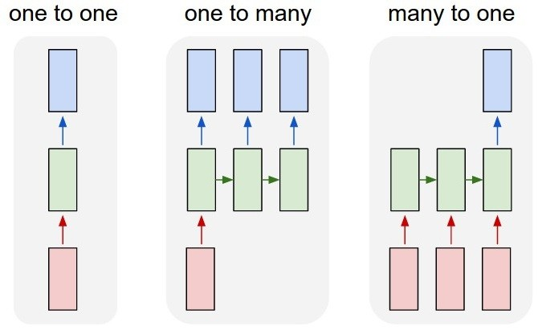
Types of RNN
Courtesy: Andrej Karpathy

Slide 15
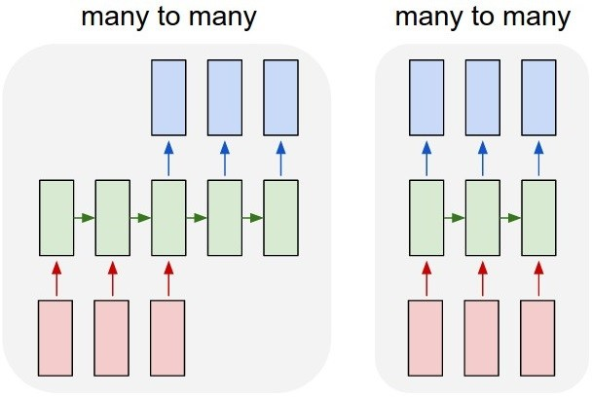
Types of RNN
Courtesy: Andrej Karpathy

Slide 16
Types of RNN and Applications
One to one – Generic neural network, Image classification
One to many – Music generation, Image Captioning
Many to one – Movie review or Sentiment Analysis
Many to many – Machine translation Synced
Many to many – Video classification

Slide 17
In This Segment
Sequence Learning
Recurrent Neural Network (RNN) Types of RNN
Learning in RNN Issues in RNN
Long Short Term Memory Unit (LSTM) Gated Recurrent Unit (GRU) Bidirectional RNN
1
2
3
4
5
6
7
8

Slide 18
Forward Propagation in RNN
s_{t} is the state of the network at time step t .
yˆ₁
yˆ₂
yˆ₃
yˆ_{Ty}
s₀ = 0
s_{t} = σ(Ux_{t} + Ws_{t−1} + b) yˆ_{t} = g(Vs_{t} + c)
or
yˆ_{t} = f (x_{t} , s_{t−1}, W, U, V, b, c)
The parameters
W, U, V, b, c are shared across time steps.
V
V
V
V
s₀
W
s₁
s₂
^{s}Tx −1
^{s}Tx
. . .
W
W
W
W
U
U
U
U
x₁
x₂
x₃
^{x}Tx

Slide 19
Back Propagation in RNN
yˆ₁
yˆ₂
yˆ₃
yˆ_{Ty}
Loss function
V
V
V
V
Y
Ty
L (yˆ , y ) = P(yˆ | yˆ
, . . . , yˆ )
s₀
W
s₁
s₂
^{s}Tx −1
^{s}Tx
t t t t t−1
1
. . .
t =1
W
W
W
W
Overall Loss
U
U
U
U
Σ
Ty
L(yˆ, y ) = L (yˆ , y )
t t t
x₁
x₂
x₃
t =1
^{x}Tx

Slide 20
Back Propagation in RNN
L
L₁
L₂
L₃
^{L}Ty
yˆ₁
yˆ₂
yˆ₃
yˆ_{Ty}
V
V
V
V
s₀
W
W
W
W
s
s
s
. . .
s
1
2
3
Tx
U
x₁
U
x₂
U
x₃
U
^{x}Tx
Back-propagation through time.

Slide 21

In This Segment
Sequence Learning
Recurrent Neural Network (RNN) Types of RNN
Learning in RNN Issues in RNN
Long Short Term Memory Unit (LSTM) Gated Recurrent Unit (GRU) Bidirectional RNN
1
2
3
4
5
6
7
8

Slide 22
Issue of Maintaining States
The old information gets morphed by the current input at each new time step. After t steps the information stored at time step t − k (for some k < t ) gets
completely morphed so much that it would be impossible to extract the original information stored at time step t − k .
It is very hard to assign the responsibility of the error caused at time step t to the events that occurred at time step t − k .
Basically depends on the size of memory that is available.

Slide 23
Strategy to Maintain States
Selectively write on the states.
Selectively read the already written content.
Selectively forget (erase) some content.

Slide 24
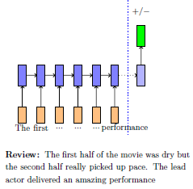
Sentiment Analysis
RNN reads the document from left to right and after every word updates the state.
By the time we reach the end of the document the information obtained from the first few words is completely lost.
Ideally we want to
forget the information added by stop words (a, the, etc.).
selectively read the information added by previous sentiment bearing words (awesome, amazing, etc.)
selectively write new information from the current word to the state.
Mitesh M. Khapra

Slide 25
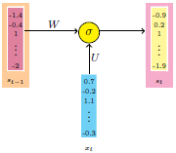
Selective write
Recall that in RNNs we use s_{t−1} to compute s_{t} .
s_{t} = σ(Ws_{t−1} + Ux_{t} + b)
Mitesh M. Khapra

Slide 26
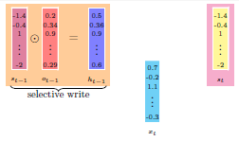
Selective write
Introduce a vector o_{t−1} which decides what fraction of each element of s_{t−1}
should be passed to the next state.
Each element of o_{t−1} gets multiplied with the corresponding element of s_{t−1}. Each element of o_{t−1} is restricted to be between 0 and 1.
The RNN has to learn o_{t−1} along with the other parameters (W, U, V ).
Mitesh M. Khapra

Slide 27
Selective write
Compute o_{t−1} and h_{t−1} as
o_{t−1} = σ(W_{o}h_{t−2} + U_{o}x_{t−1} + b_{o} )
^{h}t−1 = ºt−1 Ⓢ σ(^{s}t−1)
The parameters (W_{o}, U_{o}, b_{o} ) are learned along with the existing parameters
(W, U, V ).
The sigmoid function ensures that the values are between 0 and 1.
o_{t} is called the output gate as it decides how much to pass (write) to the next time step.
Mitesh M. Khapra

Slide 28
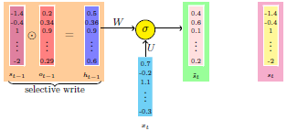
Compute State
h_{t−1} and x_{t} are used to compute the new state at the next time step.
˜s_{t} = σ(Wh_{t−1} + Ux_{t} + b)
Mitesh M. Khapra

Slide 29
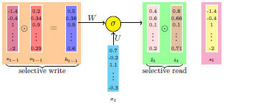
Selective Read
˜s_{t} captures all the information from the previous state h_{t−1} and the current input x_{t} .
To do selective read, introduce another gate called the input gate.
i_{t} = σ(W_{i} h_{t−1} + U_{i} x_{t} + b_{i} )
Selectively Read = i_{t} Ⓢ ˜s_{t}
Mitesh M. Khapra

Slide 30
Selective Read
˜s_{t} captures all the information from the previous state h_{t−1} and the current input x_{t} .
To do selective read, introduce another gate called the input gate.
s_{t} = s_{t−1} + i_{t} Ⓢ ˜s_{t}
Mitesh M. Khapra

Slide 31
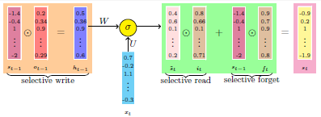
Selective Forget
To do selective forget, introduce another gate called the forget gate.
f_{t} = σ(W_{f} h_{t−1} + U_{f} x_{t} + b_{f} )
s_{t} = f_{t} Ⓢ s_{t−1} + i_{t} Ⓢ ˜s_{t}
Mitesh M. Khapra

Slide 32
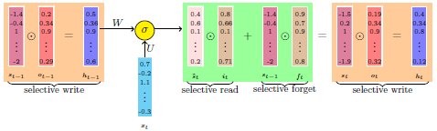
Full LSTM
3 states
3 gates
˜s_{t} = σ(Wh_{t−1} + Ux_{t} + b)
o_{t} = σ(W_{o}h_{t−1} + U_{o}x_{t} + b_{o} )
i_{t} = σ(W_{i} h_{t−1} + U_{i} x_{t} + b_{i} )
s_{t} = f_{t} Ⓢ s_{t 1} + i_{t} Ⓢ ˜s_{t}
−
h = o Ⓢ σ(s_{t} )
f_{t} = σ(W_{f} h_{t−1} + U_{f} x_{t} + b_{f} )
t t
yˆ_{t} = g(Vs_{t} + c)
Mitesh M. Khapra

Slide 33
In This Segment
Sequence Learning
Recurrent Neural Network (RNN) Types of RNN
Learning in RNN Issues in RNN
Long Short Term Memory Unit (LSTM) Gated Recurrent Unit (GRU) Bidirectional RNN
1
2
3
4
5
6
7
8

Slide 34
Long Short Term Memory Unit (LSTM)
Another representation
3 gates are used – Update gate Γ_{u} , Forget gate Γ_{f} and Output gate Γ_{o} .
c˜^{<t >} = tanh(W_{c} [a^{<t−1>}, x^{<t>}] + b_{c} ) Γ_{u} = σ(W_{u} [a^{<t−1>}, x^{<t>} + b_{u} ])
Γ_{f} = σ(W_{f} [a^{<t−1>}, x^{<t>} + b_{f} ]) Γ_{o} = σ(W_{o} [a^{<t−1>}, x^{<t>} + b_{o} ])
_{c}<t> _{= Γu ∗ c˜}<t > _{+ Γf ∗ c}<t−1>
a^{<t>} = Γ_{o} ∗ tanh(c^{<t>})

Slide 35



LSTM
_{c}t−1
Ⓢ
+
_{c}t
tanh
_{f} t
Ⓢ
Ⓢ
_{a}<t>
_{u}t
c˜^{t}
_{o}t
softmax
_{a}<t−1>
Forget
Update
tanh
Output
_{y}<t>
_{x}<t>

Slide 36






LSTM
_{c}t−1
Ⓢ
+
_{c}t
_{c}t−1
Ⓢ
+
_{c}t
tanh
tanh
_{f} t
Ⓢ
Ⓢ
_{a}<t>
_{f} t
Ⓢ
Ⓢ
_{a}<t>
_{u}t
c˜^{t}
_{o}t
_{u}t
c˜^{t}
_{o}t
_{a}<t−1>
Forget
Update
Output
softmax
_{a}<t−1>
Forget
Update
Output
softmax
tanh
tanh
_{y}<t>
_{y}<t>
_{x}<t>
_{x}<t>

Slide 37
In This Segment
Sequence Learning
Recurrent Neural Network (RNN) Types of RNN
Learning in RNN Issues in RNN
Long Short Term Memory Unit (LSTM) Gated Recurrent Unit (GRU) Bidirectional RNN
1
2
3
4
5
6
7
8

Slide 38
Gated Recurrent Unit (GRU)
Introduce a memory cell c^{<t>} = a^{<t>}. Candidate for replacing c^{<t>} is given as c˜^{<t >}.
The decision whether to update c^{<t>} with c˜^{<t >} is given by the update gate Γ_{u} .
Γ_{u} takes the value of 0 or 1.
c˜^{<t >} = tanh(W_{c} [Γ_{r} ∗ c^{<t−1>}, x^{<t>}] + b_{c} ) Γ_{u} = σ(W_{u} [c^{<t−1>}, x^{<t>} + b_{u} ])
Γ_{r} = σ(W_{r} [c^{<t−1>}, x^{<t>} + b_{r} ])
c^{<t>} = Γ_{u} ∗ c˜^{<t >} + (1 − Γ_{u} ) ∗ c^{<t−1>} _{a}<t> _{= c}<t>

Slide 39
Gated Recurrent Unit (GRU)
_{y}<t>
_{c}<t>
_{c}<t−1>
_{c˜}<t >
Γ_{u}
Tanh
σ
_{x}<t>

Slide 40
Gated Recurrent Unit (GRU)
_{y}<t>
_{y}<t>
_{y}<t>
_{c}<t>
_{c}<t>
_{c}<t>
_{c}<t−1>
_{c˜}<t >
_{c}<t−1>
_{c˜}<t >
_{c}<t−1>
_{c˜}<t >
Γ_{u}
Γ_{u}
Γ_{u}
Tanh
σ
Tanh
σ
Tanh
σ
_{x}<t>
_{x}<t>
_{x}<t>

Slide 41
In This Segment
Sequence Learning
Recurrent Neural Network (RNN) Types of RNN
Learning in RNN Issues in RNN
Long Short Term Memory Unit (LSTM) Gated Recurrent Unit (GRU) Bidirectional RNN
1
2
3
4
5
6
7
8

Slide 42
Bidirectional RNN (BRNN)
Forward and backward connections. The blocks can be RNN, GRU, LSTM. Mostly used in the NLP.
Acyclic graph
Example: Name entity recognition He said “Teddy bear is soft.”
He said “Teddy Roosevelt was a President.”

Slide 43







BRNN architecture
_{y}<1>
_{y}<2>
_{y}<2>
→−_{a} <1>
←−_{a} <1>
→−_{a} <2>
←−_{a} <2>
→−_{a} <3>
←−_{a} <3>
_{x}<1>
_{x}<2>
_{x}<3>
_{yˆ}<t > _{= g(Wy [}→−_{a} <t>←−_{a} <t>_{x}<t>_{] + by )}

Slide 44
Summary
Use GRU, when dependency is short. Eg: Weather forecasting
Use LSTM, when dependency is long. Eg: NLP Translation
Use BRNN, dependency is in both direction. Eg: Stock prediction

Slide 45

References
1
Deep Learning by Ian Goodfellow, Yoshua Bengio, Aaron Courville
https://www.deeplearningbook.org/
2
Deep Learning with Python by Francois Chollet.
https://livebook.manning.com/book/deep-learning-with-python/

